Slide 1
Groningen
Investment Team
Company Name

Slide 2
Program
Company profile
Business description
Industry overview
Catalysts
Financial Analysis
Risks
Management
Proposal

Slide 3
Company Profile
- Describe the company in general
- Add some news about the company
- Most recent returns

Slide 4
Business Description
- What the company is actually doing?
- Overview of the products/services
- How they are conducting their business

Slide 5
Industry Overview
- Analyze the industry
- List the competitors
- General trends in this sector

Slide 6
Catalyst
- Why this company and not the competitors?
- What is so different/special that you decided to pitch it?

Slide 7
Financial Analysis
- Analysis of financial statements of the company
(look it up in the internet if you have no idea)
- DCF and other valuation methods
- Show the intrinsic value of this stock

Slide 8
Risks
- List the risks that might be a problem
- Here you can also list the risks coming from the
macroeconomic perspective

Slide 9
Management
- Describe why the company’s management
(You can typically find all that info on the company’s website)

Slide 10
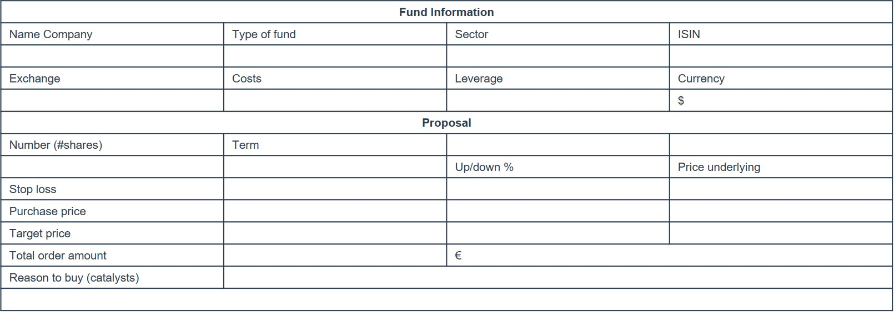
Proposal

Slide 11
Questions

